Slide 1
The SAR in Rapid Time model – key features and experiences of using it
[Presenter name/participating organisation]
[Date]
Notes:
Note to presenter – you don’t need to use all of these slides you can pick out the ones that you think are most useful. There are notes for each slide to help you make the most of the content.

Slide 2
Learning in the COVID-19 context
An urgent need for a rapid process.
Proportionate given other demands.
Can identify learning from safeguarding incidents occurring in the new corona context.
Makes it possible to share locally, regionally and nationally in a timely way.
Relevant also as lockdown is eased; for recovery and renewal.
Part of the DHSC’s Covid-19 Action Plan for Social Care
Notes:
This slide outlines some of the reasons and need for a proportionate, swifter SAR review process. The DHSC funded the development of the new model.

Slide 3
More detail available in recorded training modules
https://www.scie.org.uk/safeguarding/adults/reviews/in-rapid-time/training
Delivered by Dr Sheila Fish,
Independent Consultant & SCIE Associate
Notes:
Link to the training modules – important for those with key roles to spend some time looking at these – in particular the SAR subgroup (that agrees which SARs will be commissioned), case reviewer, board manager and independent chair.

Slide 4
Published examples
Dorset
https://www.dorsetcouncil.gov.uk/documents/35024/281402/Dorset+SAR+Systems+Findings+Report++Katherine+October+14.pdf/df37056a-51cd-68c2-5133-491180d96d51
Newham
https://www.newham.gov.uk/downloads/file/2750/newham-sar-in-rapid-time-peggy
https://www.newham.gov.uk/downloads/file/2751/newham-sar-peggy-system-findings-response
Notes:
Example reports of boards that have undertaken SARs using the new SAR in Rapid Time methodology. Useful for board managers and chairs to be clear that the final report is not a traditional one and the final content is systems findings as opposed to case specific findings.

Slide 5
SAR in Rapid Time What it is and what it isn’t
An additional tool in SAB tool boxes – most pared back option in terms of capacity and turnaround
imposition or requirement
one-size-fits-all solution
panacea
Notes:
Not a one-size fits all solution.

Slide 6
SAR in Rapid Time and tools
Agenda incl. 10 questions
Project plan template
Share chronology and key records with reviewers; send out invites for meetings
Reviewers produce Early Analysis Report
Structured multi-agency workshop
Set up meeting with leads from involved agencies and reviewers
2
2
5
3
Reviewers produce brief systems findings report
Input from agency leads to confirm systems findings
5
4
Record check template
Invitation email
Early Analysis report template
Agenda template and opener
Feedback form template
Report template
Notes:
add link to web page tools when we have it
Provides overview of the key phases of the review process and their associated tools and templates to use to support the process which may be accessed on the SCIE website at https://www.scie.org.uk/safeguarding/adults/reviews/in-rapid-time/tools-templates

Slide 7
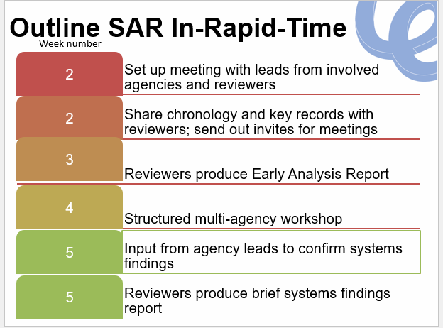
Couched in each SAB’s own processes
Referral
Decision making
Informing & engaging the person, family
Governance
Improvement action
Notes:
Shows how the review process fits within the local SAB process of SAR referral, decision-making and linking with the family. Once the SAR is completed again the usual local SAB processes are followed to achieve governance, action planning and improvement work.

Slide 8
The model, process and tools assume key methodological principles
Assumes and promotes a ‘systems approach’ to practice reviews.
In line with NHS Patient Safety developments; seen as a discrete specialism see https://www.england.nhs.uk/patient-safety/incident-response-framework/.
Reflected in the SAR Quality Markers.
Focuses on generating qualitative understandings of social and organisational factors that make it harder or easier for practitioners/clinicians to do personalised, timely and effective adult safeguarding.
Not ‘root causes’ or linear causality.
Notes:
The review methodology uses a systems approach – and is designed to produce systems findings, (i.e. learning about the functioning of the safeguarding system). The analysis begins with the individual case under review but then moves beyond that to provide learning about the conditions within the system that are helping or hindering good safeguarding practice. Really vital that key leaders involved understand this to ensure they have a clear expectation of the kind of findings that will be produced.

Slide 9
SAR Quality Markers
Notes:
The SAR Quality Markers are accepted as national standards that provide best practice prompts for commissioners or reviews , boards, partnerships and case reviewers to use to support their roles. Quality Marker 4 supports those involved to think about how they can achieve clarity of purpose and underlines the importance of the review should aim to achieve systems learning, (i.e. going beyond only critiquing the individual case).

Slide 10
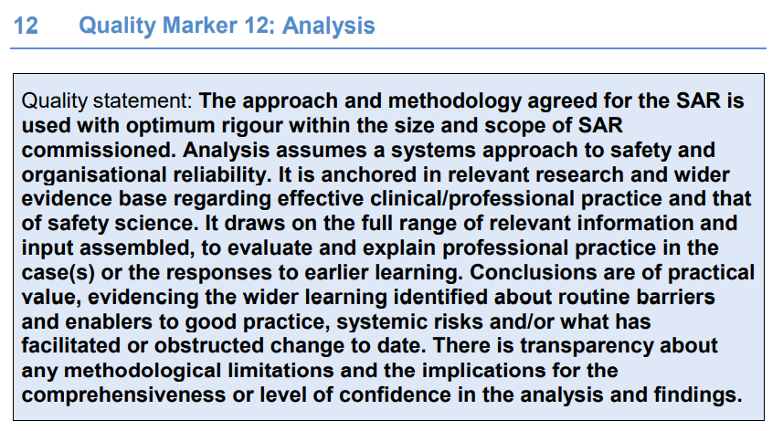
SAR Quality Markers
Notes:
The SAR Quality Markers are accepted as national standards that provide best practice prompts for commissioners or reviews, boards, partnerships and case reviewers to use to support their roles. Quality Marker 12 supports with achieving a good quality of analysis in your reviews – and again highlights the value of a systems approach.

Slide 11
SAR in Rapid Time model encourages clarity about the kind of learning needed
The SAR in Rapid Time enables SABs to move from describing practice problems:
to illuminating what lies behind those practice problems,
to understanding the social and organisational drivers for current practice problems.
When we say we “keep learning the same things”, is it because we keep identifying the practice problems?
Notes:
The kind of learning that a systems approach enables will include a consideration of the social and organisational factors that are influencing how practice is working on the frontline.

Slide 12
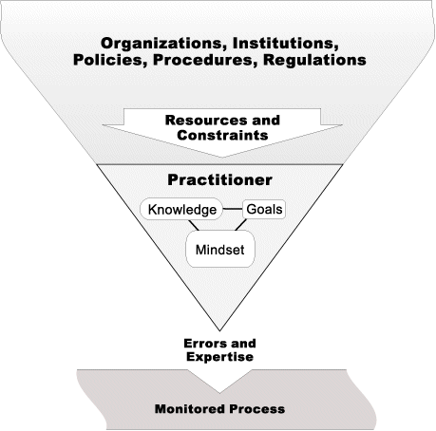
Effective approaches to learning – focus on systems findings
What is making it harder and what is making it easier to do timely and effective safeguarding?
Organisational triangle reproduced from: Cook, Richard & Woods, David & Miller, C.A. (1998). A Tale of Two Stories: Contrasting Views of Patient Safety. See: https://www.researchgate.net/publication/245102691_A_Tale_of_Two_Stories_Contrasting_Views_of_Patient_Safety
Notes:
These images provide helpful ways of thinking about some of the key elements of the SCIE approach to systems learning.
- The mosquito analogy illustrates how a typical and immediate response to mosquitos is to swat them away one by one, but they will keep coming back. A more effective and longer-term solution would be to drain the swamp where they are breeding. The swamp represents the underlying conditions within an organisation or system which may be hindering good effective safeguarding practice.
- The organisational triangle illustrates now there is a considerable weight of procedures, policies and regulations that strongly influence how a practitioner performs at the sharp pointy end of frontline practice. When we review a case it is important that the analysis goes beyond a focus on the individual practitioner’s practice as that is only one part of the equation in understanding how safeguarding is working in a system.
- The open window illustrates the concept of using the review of an individual case to open a window on the wider system, this provides an opportunity for the commissioners of the review to determine which particular ’window’ they think they can most usefully explore through the particular case. This concept goes beyond a focus on an individual case an enables the reviewer to look more broadly at the relevant systems issues.

Slide 13
SAR in Rapid Time output is a succinct systems findings report
Nb. There are inevitably compromises to be made, for the benefits of reducing capacity demand and increasing speed of turnaround
5-6 pages
only brief paragraph of the case
focus on the systems findings.
Feedback to-date positive:
very practical
keeps focus on action required
no chance to be distracted by case detail.
Notes:
The SAR in Rapid Time model is intended to provide a succinct, accessible report which can be as brief as 5-6 pages with the major focus being on the systems findings. So far feedback from the boards that have used the SAR in Rapid Time model suggests that most boards choose to produce a slightly longer report perhaps 9-12 pages, but it will be important not to fall into the trap of trying to write a traditional style report.

Slide 14
This has implications for …
It takes courage to really hold that mirror up to ourselves and illuminate systemic barriers.
How to decide what actions to take to address them?
Moving beyond a focus only individual staff as the audience for learning.
Thinking more in terms of organisational development.
Who needs to be involved?
How to cultivate ownership across partners?
How to undertake evaluation of whether you are really making a difference?
Notes:
Using a systems learning approach has a number of implications to consider, the findings can be quite challenging and potentially lead to changes to how your safeguarding system functions. Once the report is signed-off the board will want to start thinking about the organisational improvement and action planning that is needed. Achieving improvement will have its own challenges and engagement and ownership of change will be key.

Slide 15
SCIE reflections on using the SAR in Rapid Time model
Reviewers found analytic tools incredibly useful; more revolutionary than the ‘rapid’ elements.
Planning to use in a range of ‘bigger’ and smaller review processes.
Underlined need for basic analytic competencies.
Highlighted benefits of analytic supervision particularly when delivering to tight turnaround.
Quite a shift for many boards - moving beyond identifying ‘practice problems’ to understanding what lies behind them.
Leading to a revisiting of the purpose as to drive improvements; thinking more strategically about commissioning.
Strong feedback about the strengths of two reviewers, one internal.
Provoking discussions about when, how and to what end detail of the person themselves is included in the published report.
Notes:
This is a summary of some of the feedback that SCIE has received from boards and reviewers who have used the SAR in Rapid Time model.

Slide 16
Reflections, comments, questions, concerns?
Notes:
This is a summary of some of the feedback that SCIE has received from boards and reviewers who have used the SAR in Rapid Time model.

Slide 17
Thank you For more information please visit www.scie.org.uk

